Slide 1


AI classification project

Slide 2
Team
Organisation
Project
Conclusion
Discussion
SUMMARY

Slide 3





TEAMs
AMMAR Sana
Strasbourg
CRISTIANINI Marceau
Marseille
HUCK Geoffroy
Paris
HEADLEY
Ryan
Paris
Masson Antoine
Marseille

Slide 4
Project Organisation
Team Objectives
Individual objectives
ORGANIZATION
SHARING

Slide 5
Project
- Main Concept -
CREATING AND PREPARING THE DATASET
MODEL INITIALIZATION
MODEL TRAINING
MODEL MODIFICATION AND OPTIMIZATION
MODEL VALIDATION

Slide 6
Project
- Main Concept -
EVALUATION AND PREDICTION THROUGH THE FINAL MODEL
RESULTS AND VISUAL PRESENTATION

Slide 7



Organization
Communication

Slide 8
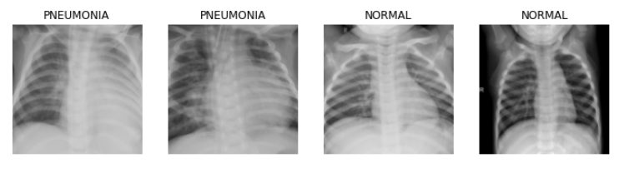
Dataset
5865 X-ray images
Training Images
Testing Images
validation images

Slide 9







Project Technologie

Slide 10
k-Nearest Neighbours
Support Vector Machine
Convolution Neural Network
classifiers

Slide 11
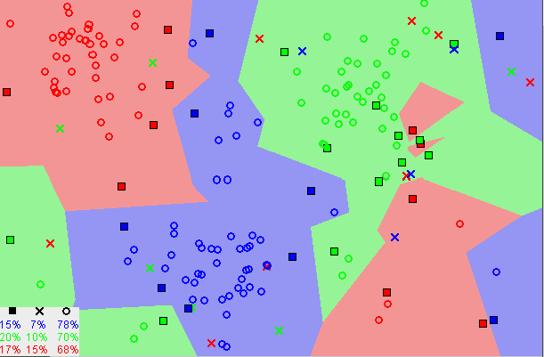
kNN
"Tell me who your neighbour is and I'll tell you who you are"
Advantages
simple and easy to use
no need to build a model
versatile algorithm: classification, regression and search

Slide 12
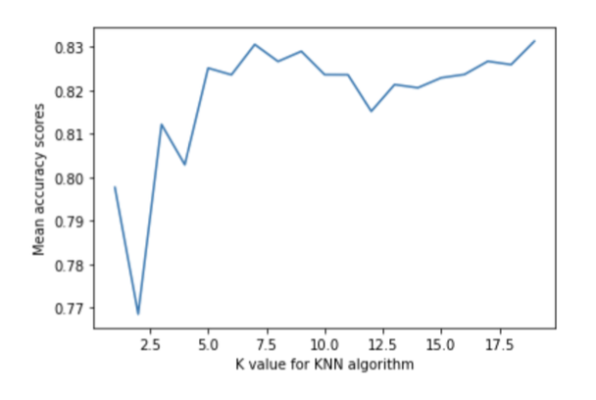
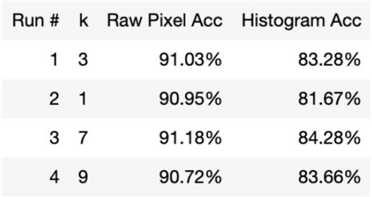
kNN
Cross validation for the best k-value
Raw images better than histograms

Slide 13
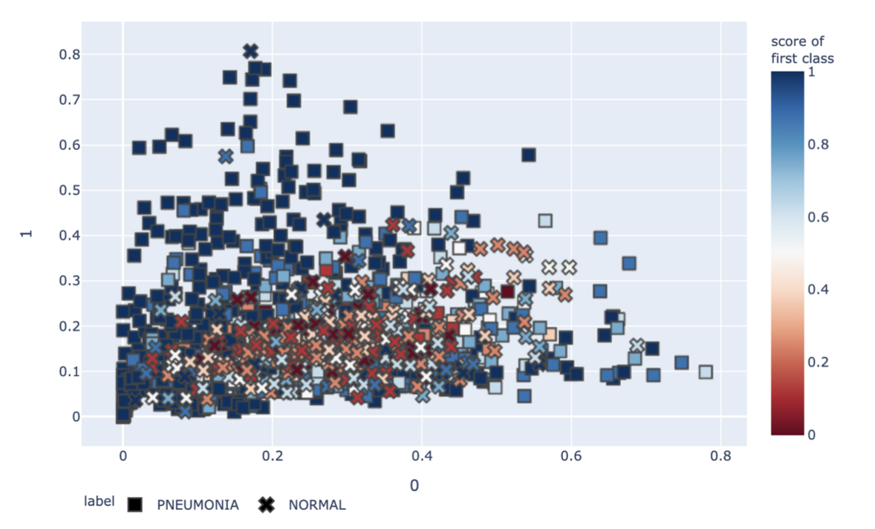
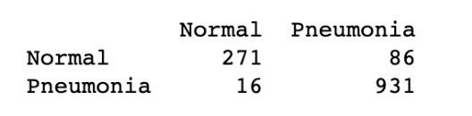
kNN
Accuracy of 91%
Pneumonia
Recall 98%
Precision 92%
F1-score 95%

Slide 14
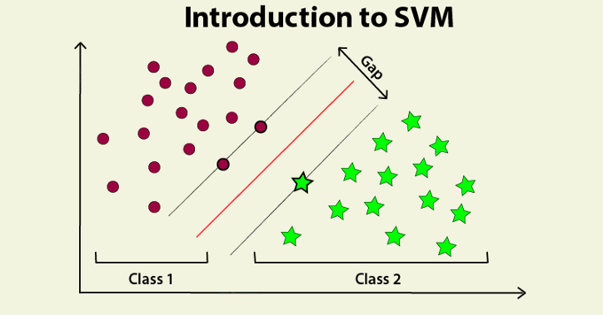
SVM
Find the widest possible street to divide the categories
Generate an hyperplane

Slide 15
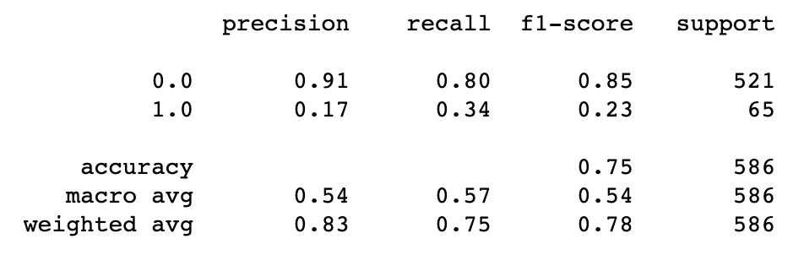
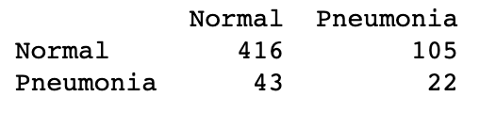
SVM
Accuracy:
80 % after training
75 % after validation
Pneumonia
Recall 34%
Precision 17%

Slide 16
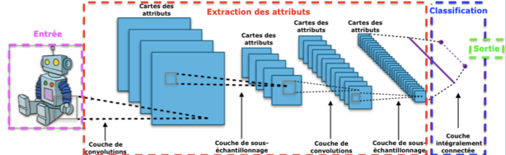
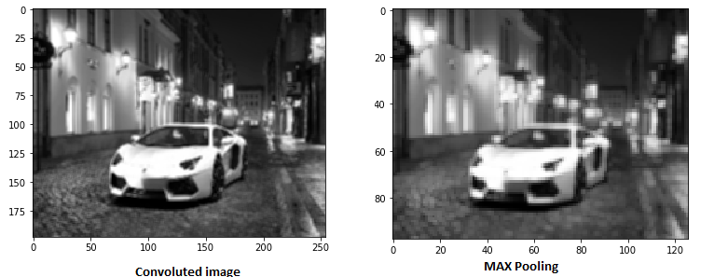
cnn
Convolutional Layer
Pooling Layer
Output Layer

Slide 17
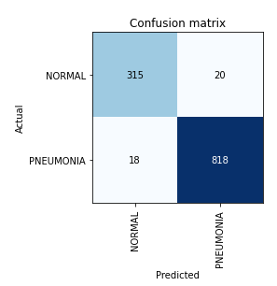
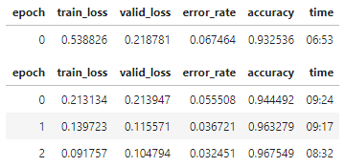
cnn
Accuracy 96%
Pneumonia ​
Recall 98.6%​
Precision 96.7%​
F1-score 97.6%

Slide 18
Discussion
Which metrics measure performance?
Is accuracy the best metric ?
Is recall or precision more important in this project ?
Are all of our results conclusive ?
KNN histograms
SVM math

Slide 19
Conclusion
CNN provided very effective results
CNN pneumonic recall of 98.6%
Other classifiers can be optimized for better results

Slide 20
THANK YOU FOR YOUR ATTENTION
QUESTIONS ?

